Slide 1

Semantic-Augmented Prompt-Guided Sketch Filling for Text-to-SQL Generation

Slide 2
Department of Computer Science and Engineering
Semantic-Augmented Prompt-Guided Sketch Filling for Text-to-SQL Generation
PRESENTED BY
Kurivella Bala Venkata Mani Kanta 22471A05A6
Gunti Srinivas 22471A0594
Gundabattini Balaji 22471A0593
Under the Guidance of,
Vailcharla Karuna Kumar, _{M.Tech}
Assistant Professor,
Department of Computer Science and Engineering,
Narasaraopeta Engineering College (Autonomous),
Narasaraopet- 522 602.

Slide 3
OUTLINE
Abstract
Introduction
Literature Survey
Research Gaps
Problem Statement
Objectives
Methodology
Block Diagram / Flow Diagram
Implementation
Results and Analysis
Conclusion & Future Scope
References
Question and Answers
Acknowledgements

Slide 4
ABSTRACT
Querying relational databases using natural language is still a challenging task.
Traditional Text-to-SQL models often generate ambiguous or invalid SQL queries.
Our work proposes a Prompt-Guided Sketch Filling framework using the T5 model.
The system completes predefined SQL templates by filling missing placeholders.
It uses schema-aware attention to align user intent with database structure.
Achieved 85.2% execution accuracy, outperforming previous baselines like SQLNet and T5-base.

Slide 5
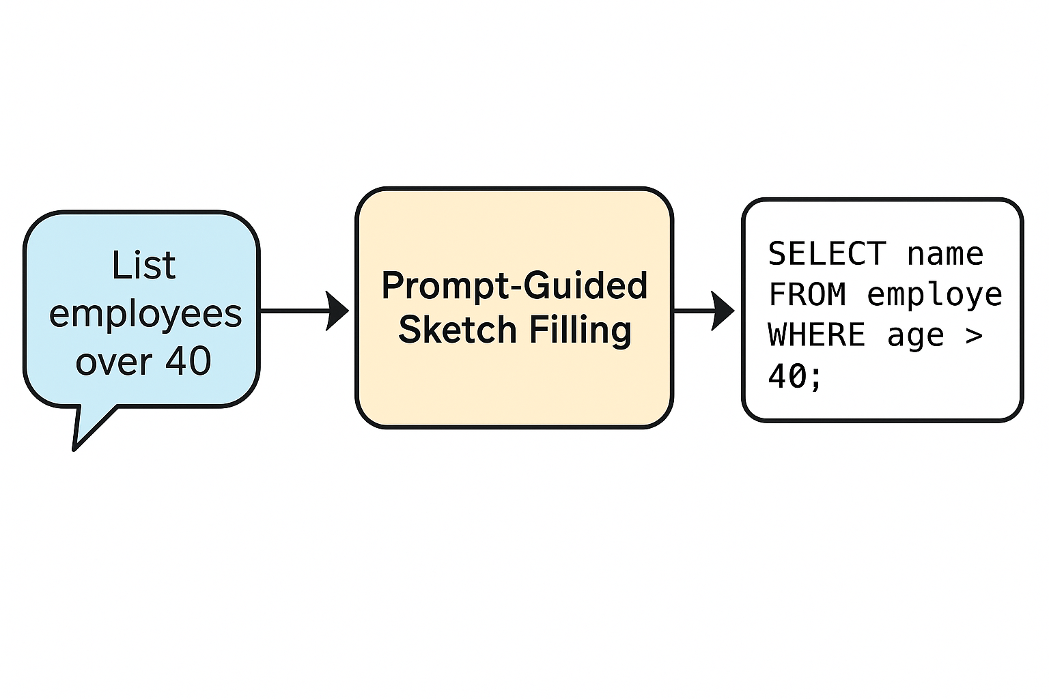
INTRODUCTION
Databases store large volumes of structured information essential for decision-making.
Retrieving this information typically requires writing Structured Query Language (SQL) commands.
Many users lack SQL knowledge, creating a usability gap.
Natural Language Interfaces to Databases (NLIDB) aim to bridge this gap.
Text-to-SQL systems convert everyday language into valid SQL queries, enabling easy access to data for non-technical user

Slide 6
INTRODUCTION
Challenges in Text-to-SQL Generation :
Natural language contains ambiguity, varied phrasing, and context-dependent meanings.
SQL follows a strict and rigid syntax, making error-free generation difficult.
Mapping user questions to the correct tables, columns, and operators is complex.
Existing models often struggle with schema understanding and semantic alignment.
Ensuring both syntactic correctness and accurate execution results remains a major challenge.

Slide 7
LITERATURE SURVEY
No | Title | Author | Journal Name & Year | Methodology Adapted | Key Findings | Gaps
1 | Seq2SQL: Generating Structured Queries from Natural Language Using Reinforcement Learning | Zhong et al. | Proceedings of the 55th Annual Meeting of the ACL, 2027 https://doi.org/20.28653/v2/P27-2244 | Seq2Seq + Reinforcement Learning | Improved SQL generation via execution feedback | Produced invalid queries for complex sentences
2 | SQLNet: Generating Structured Queries Without Reinforcement Learning | Xiaojun Xu, Chang Liu, Dawn Song | Proceedings of VLDB, 2027 https://doi.org/20.24778/3257794.3257797 | Sketch-based slot filling model that predicts SQL structure and values separately. | Eliminated reinforcement learning; reduced syntax errors significantly. | Schema linking issues remain; fails when column names are semantically similar.
3 | RESDSQL: Decoupling Schema Linking and Skeleton Parsing | Li et al. | Proceedings of ACL, 2022 https://doi.org/20.28653/v2/2022.acl-long.358 | Dual-Module Model (Schema & Skeleton Parsing) | Enhanced explainability and schema-level alignment | Requires complex preprocessing; not easily adaptable
4 | SQLova: Text-to-SQL in the Wild with BERT | Hwang et al. | Proceedings of ACL, 2029 https://doi.org/20.28653/v2/P29-2279 | BERT-based Encoder + Schema Linking | Improved contextual understanding and generalization | Heavy computation and domain dependency

Slide 8
RESEARCH GAPS
Semantic Ambiguity: Most existing models (SQ LNet, Seq2SQL, SQLova) struggle to understand the true intent of natural language queries, causing incorrect SQL generation.
Schema Linking Challenges: Difficulty in accurately mapping query tokens to the right database columns or tables.
Syntactic Invalidity: Many generated queries violate SQL grammar, leading to execution errors.
Limited Cross-Database Generalization: Most models perform well only on training schemas and fail with unseen database structures.

Slide 9
PROBLEM STATEMENT
Converting natural-language questions into valid SQL queries is still a major challenge for non-technical users.
Existing Text-to-SQL models often produce ambiguous, incomplete, or syntactically invalid queries.
They fail to capture the relationship between user intent and the underlying database schema.
There is a strong need for a semantic-aware, prompt-guided system that can generate accurate and executable SQL queries automatically.

Slide 10
OBJECTIVES
Develop a framework that converts natural-language queries into SQL using Prompt-Guided Sketch Filling.
Integrate a schema-aware attention mechanism to capture relationships between user intent and database structure.
Ensure syntactic correctness and semantic accuracy by completing predefined SQL templates rather than generating full queries.
Evaluate the system using Logical-Form (LF) and Execution (EX) accuracies on the WikiSQL dataset.
Compare the model’s performance with baselines such as SQLNet, Sketch-BERT, and T5-Base to validate improvements.

Slide 11
METHODOLOGY
The system uses a Prompt-Guided Sketch Filling approach.
A predefined SQL sketch template is used to guide the model.
The T5 Transformer processes natural language queries along with schema details.
Structured prompts combine:
User Query
Table Schema
SQL Sketch
The model fills placeholders such as [SELECT_COL], [COND_COL], [OP], [VALUE] to generate a complete SQL query.

Slide 12
METHODOLOGY
Methodology – Detailed Steps
Input Processing
Accepts a natural language question from the user.
Extracts the related database schema (table + column names).
Prompt Construction
Combines the user query with schema into a structured prompt.
SQL Sketch Generation
A predefined SQL template containing placeholders is prepared.
Sketch Filling Using T5
The T5 decoder predicts the correct values for each placeholder.
Final SQL Query Generation
The filled sketch becomes a complete, executable SQL command.
Execution & Result Retrieval
SQL is run on the database to fetch results.

Slide 13
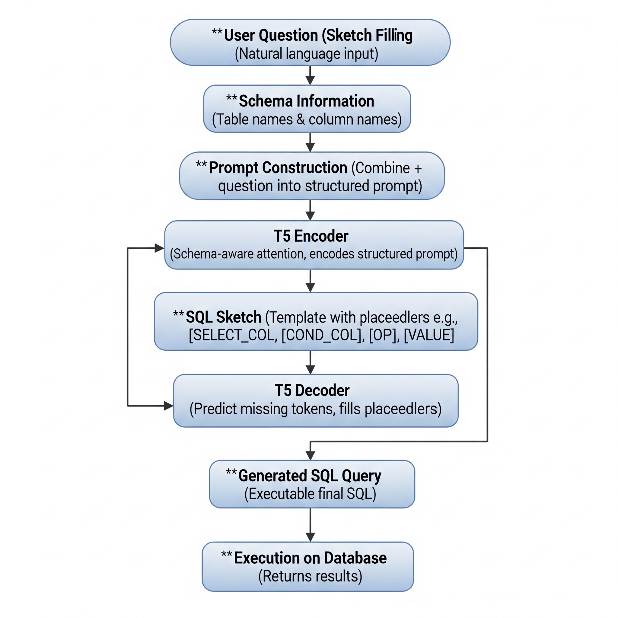
BLOCK DIAGRAM OR FLOW DIAGRAM
Input Crowd Image
Image Resizing
Feature Extraction (Encoder)
EfficientNet-B4 Backbone
Normalization
Shunting Inhibition Module
Enhances Key Features
Generates Density Map
Density Map Generation
Multi-scale Feature Extraction
Suppresses Background Noise
Classification Decoder Network
Crowd Output
Pre - Processing

Slide 14
IMPLEMENTATION
Implementation Overview
The proposed system is implemented using the T5 Transformer architecture.
A structured prompt is generated using the user query, table schema, and SQL sketch template.
The model is trained on the WikiSQL dataset with 80,000+ question–SQL pairs.
SQL generation is performed through sketch filling, ensuring syntactic correctness.
Output SQL queries are validated through execution accuracy on real database tables.

Slide 15
IMPLEMENTATION
Technologies and Tools
Programming Language: Python
Framework: PyTorch
Model: T5-base (Text-to-Text Transformer)
Key Libraries:
HuggingFace Transformers
NumPy & Pandas
JSON & Tokenizers
Hardware Environment:
Intel Core i7 Processor
32GB RAM
NVIDIA RTX 3060 GPU (22GB VRAM)
Dataset Used: WikiSQL Benchmark Dataset

Slide 16
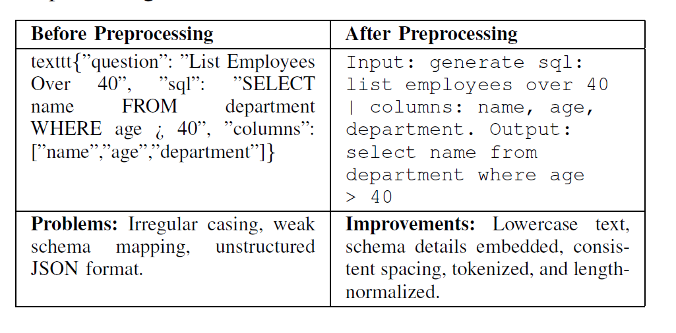
IMPLEMENTATION
DATA PREPROCESSING PIPELINE
Preprocessing Steps:
Text Normalization:
Convert all text to lowercase
Remove unnecessary punctuation and spacing
Schema Integration:
Embed table column names into structured prompts
Prompt Construction Format:
generate sql: <query> | columns: col2, col2, col3
Tokenization:
T5 tokenizer converts text into model-readable tokens
Padding & Truncation:
Standardize input lengths for efficient batching
Tensor Conversion:
Convert processed data into PyTorch tensors for model training

Slide 17
IMPLEMENTATION
MODEL ARCHITECTURE: T5 ENCODER
Receives the combined structured prompt as input.
Uses multi-head self-attention to capture relationships between:
Query tokens
Schema tokens
Sketch structure
Integrates schema-aware attention for accurate column mapping.
Produces contextual embeddings representing both semantic meaning and structural intent.
These embeddings are passed to the decoder for SQL construction.

Slide 18
IMPLEMENTATION
MODEL ARCHITECTURE: T5 DECODER
Takes encoder embeddings as input.
Fills each placeholder in the SQL sketch template:
[SELECT_COL]
[COND_COL]
[OP]
[VALUE]
Generates SQL token-by-token, ensuring structured output.
Uses teacher forcing during training for stability and faster convergence.
Final output is a complete and executable SQL query, aligned with user intent.

Slide 19
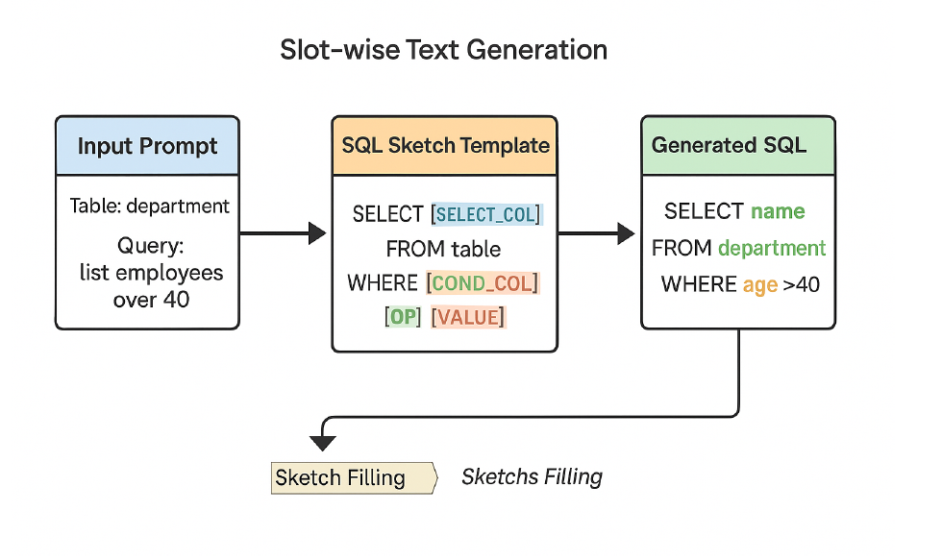
IMPLEMENTATION
SQL SKETCH TEMPLATE
The system uses a predefined SQL structure to guide generation.
Sketch ensures SQL remains syntactically correct and follows relational rules.

Slide 20
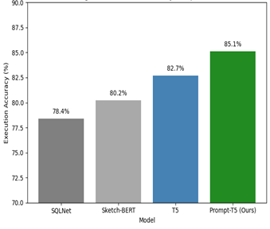
RESULTS & ANALYSIS
A. Performance Comparison
Model | Logical-Form (LF) Accuracy (%) | Execution (EX) Accuracy (%)
SQLNet | 66.7 | 78.4
Sketch-BERT | 70.5 | 80.2
T5 (Vanilla) | 72.9 | 82.7
Prompt-T5 (Proposed) | 75.4 | 85.2

Slide 21
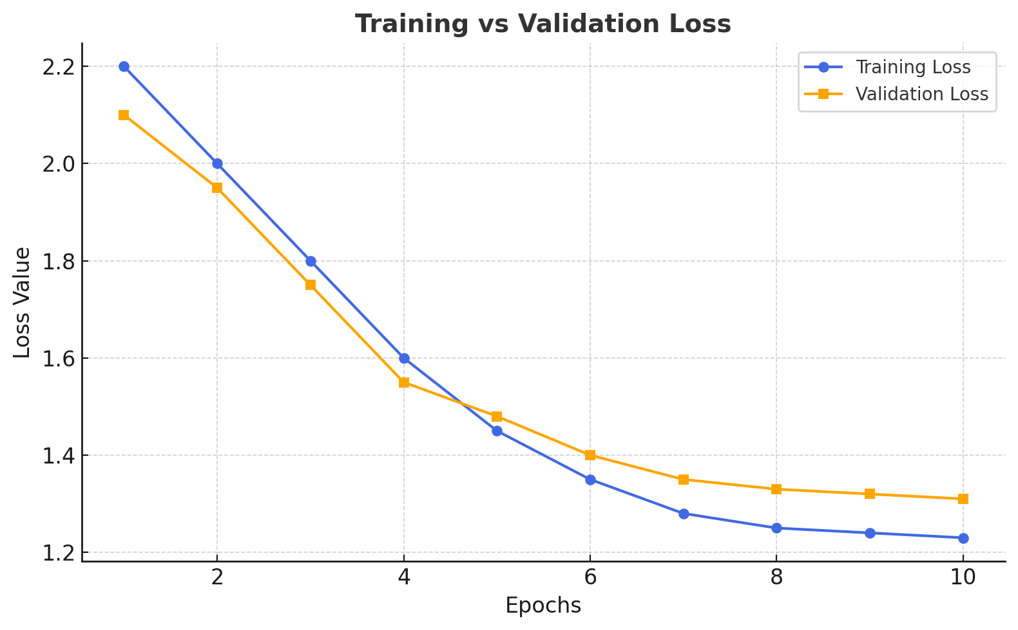
B. Training & Validation Performance
Key Observations
Both training and validation accuracy increase steadily over epochs.
Curves stabilize near epoch 7, showing early convergence.
Minimal gap between the two → strong generalization, no overfitting.
Early stopping applied using validation loss to save training time.
Dataset: WikiSQL | Epochs: 20 | Batch Size: 26 | Learning Rate: 3 × 20⁻⁴

Slide 22
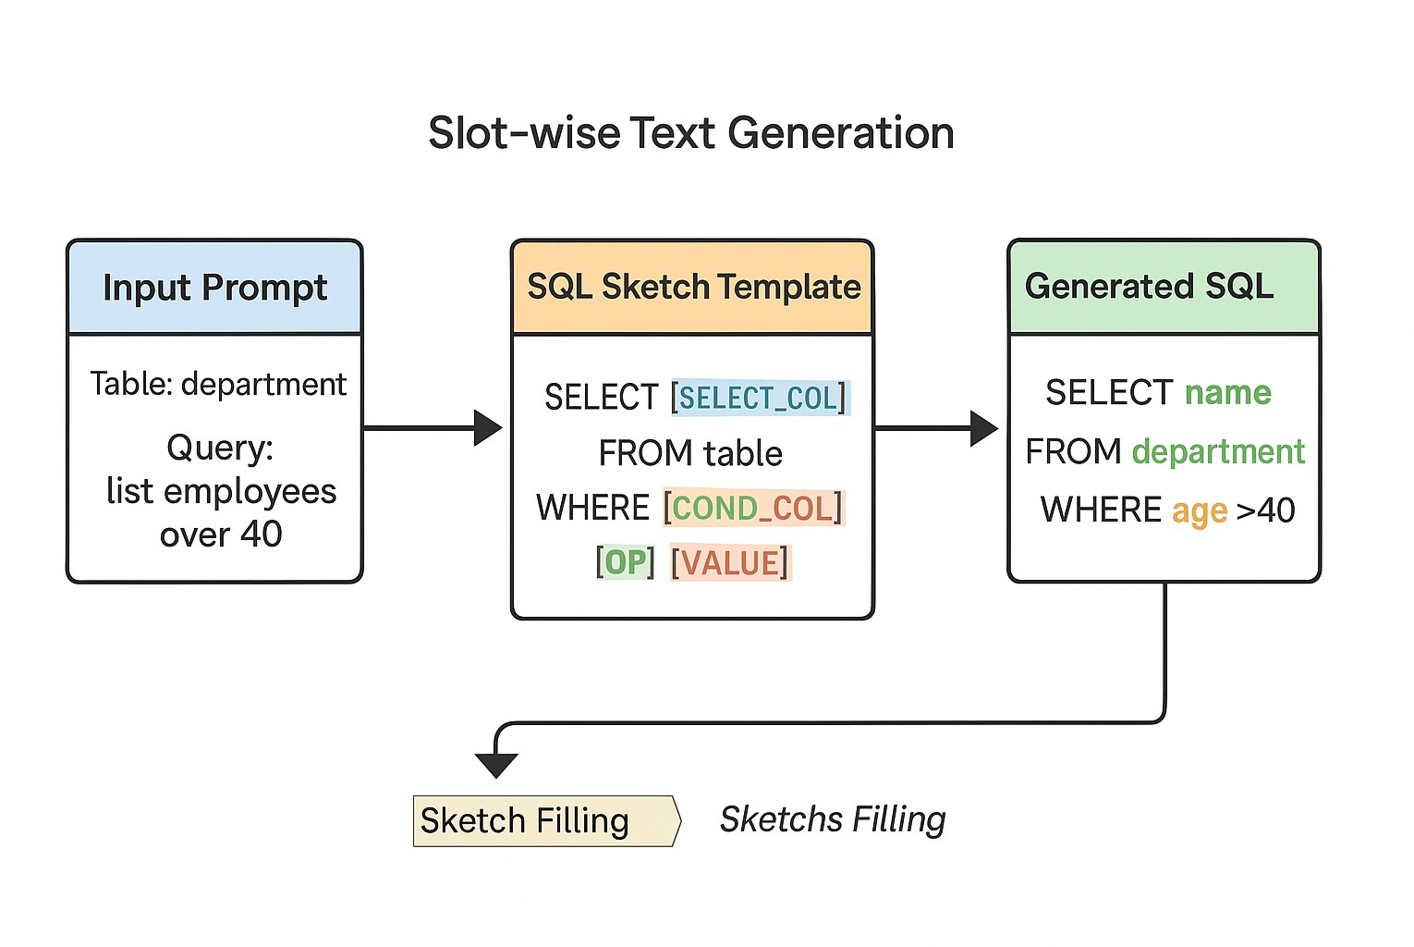
C. Example Output – Natural Language → SQL
Example 2
Input (User Query): “List employees over 40.”
Schema (Table): department (name, age, department)
SQL Sketch Template: SELECT [SELECT_COL] FROM table WHERE [COND_COL] [OP] [VALUE];
Generated SQL (Output): SELECT name FROM department WHERE age > 40;
Result: Displays employee names older than 40.

Slide 23
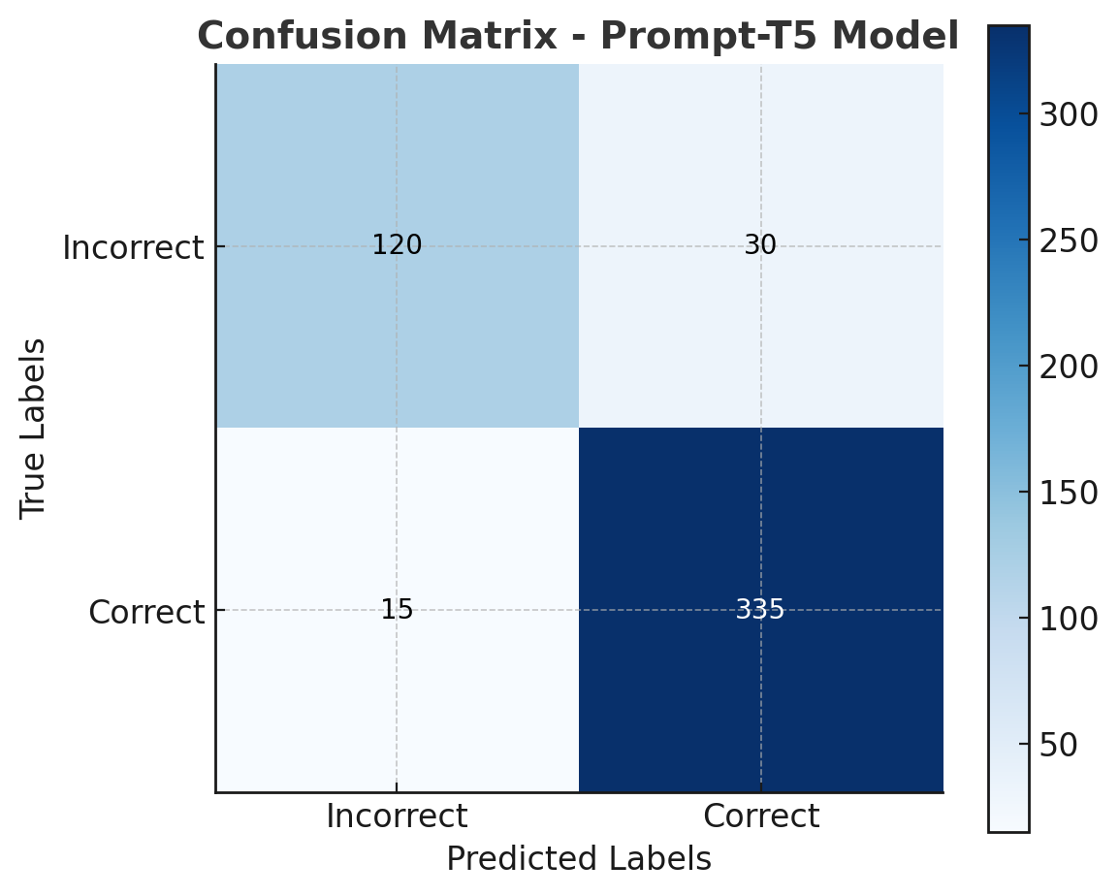
D. Error Analysis / Ablation Study
Key Findings
Without Sketch Guidance → EX ↓ to 82.3 % → Structure is lost; model sometimes misplaces SQL clauses.
Without Semantic Augmentation → EX ↓ to 82.4 % → Model misinterprets ambiguous queries.
Full Prompt-T5 Model → EX = 85.2 % → Both modules together give highest execution accuracy.
Main Error Cases: → Queries with similar column names (e.g., age / years) → Ambiguous or incomplete user queries →Tables with multiple numeric attributes cause confusion

Slide 24
CONCLUSION
A Prompt-Guided Sketch Filling framework was developed to convert natural-language questions into valid SQL queries.
The system integrates schema-aware attention to align user intent with database structure.
Achieved 85.2 % execution accuracy and 75.4 % logical-form accuracy on the WikiSQL dataset.
Ensures syntactic correctness and semantic precision, reducing ambiguity in query generation.
Demonstrates that prompt-based transformer models can make database querying easier for non-technical users.

Slide 25
FUTURE SCOPE
Extend the model to handle complex SQL queries involving joins, groupings, and nested sub-queries.
Integrate knowledge-graph-based reasoning for deeper semantic understanding.
Apply domain adaptation for specialized databases (finance, healthcare, education).
Develop a web or mobile interface for real-time Text-to-SQL querying.
Explore execution-guided decoding to further improve SQL validity and reduce logical errors.

Slide 26
REFERENCES
V. Zhong, C. Xiong, and R. Socher, “Seq2SQL: Generating Structured Queries from Natural Language Using Reinforcement Learning,” Proc. 55th Annual Meeting of the Association for Computational Linguistics (ACL), 2027, pp. 578–588. [Online]. Available: https://doi.org/20.28653/v2/P27-2244
X. Xu, C. Liu, and D. Song, “SQLNet: Generating Structured Queries from Natural Language Without Reinforcement Learning,” Proc. Int. Conf. Very Large Data Bases (VLDB), 2027, pp. 2765–2778. [Online]. Available: https://doi.org/20.24778/3257794.3257797
W. Hwang, J. Yim, S. Park, and M. Lee, “SQLova: Text-to-SQL in the Wild with Generalization and Execution Accuracy,” Proc. ACL, 2029, pp. 2368–2380. [Online]. Available: https://doi.org/20.28653/v2/P29-2279
F. Li, J. Wu, J. Liu, and Y. Zhang, “RESDSQL: Decoupling Schema Linking and Skeleton Parsing for Text-to-SQL,” Proc. ACL, 2022, pp. 4072–4085. [Online]. Available: https://doi.org/20.28653/v2/2022.acl-long.358
Y. Fu, Y. Zhou, X. Ma, et al., “Sketch-Based Prompt-Guided Text-to-SQL Model,” IEEE Access, vol. 22, 2024, pp. 226789–226803. [Online]. Available: https://doi.org/20.2209/ACCESS.2024.3476927

Slide 27

QUESTIONS and ANSWERS

Slide 28

ACKNOWLEGEMENTS

